Slide 1
Formulating estimators
We have seen how to compare different estimators for a parameter based on their expected values and variances.
Knowing how to compare estimators doesn’t tell us how to formulate an estimator.
We need to decide how to find one or more estimators for the parameters in a distribution before we can compare them.
method of moments (MoM)
maximum likelihood estimators (mle’s).
MoM is interesting from the historical perspective but is not in wide use today.
Generally if we are faced with an unknown estimation situation, we will derive the maximum likelihood estimators for the parameters.

Slide 2
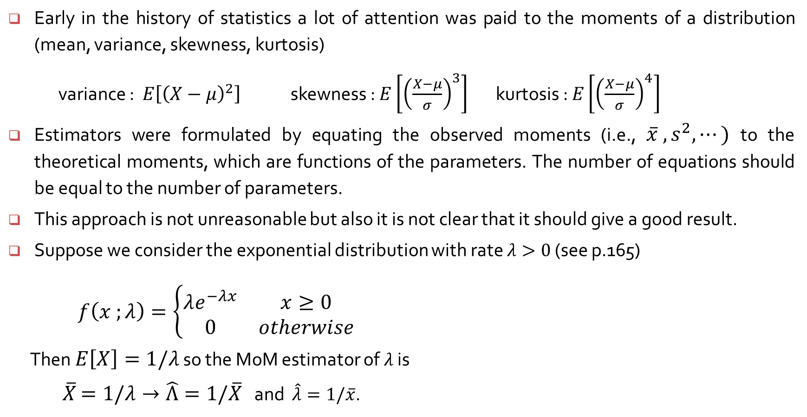
The method of moments
Early in the history of statistics a lot of attention was paid to the moments of a distribution (mean, variance, skewness, kurtosis)
variance : $E\left[{\left(X−μ\right)}^{2}\right]$ skewness : $E\left[{\left(\frac{X−μ}{σ}\right)}^{3}\right]$ kurtosis : $E\left[{\left(\frac{X−μ}{σ}\right)}^{4}\right]$
Estimators were formulated by equating the observed moments (i.e., $\overline{x} , s^{2}, ⋯)$ to the theoretical moments, which are functions of the parameters. The number of equations should be equal to the number of parameters.
This approach is not unreasonable but also it is not clear that it should give a good result.
Suppose we consider the exponential distribution with rate $λ>0$ (see p.165)
$f\left(x ;λ\right)=\left\{\begin{matrix}λe^{−λx} & x≥0 \\ 0 & otherwise\end{matrix}\right.$
Then $E\left[X\right]=1/λ$ so the MoM estimator of $λ$ is
$\overline{X}$ $=1/λ→\hat{Λ}=1/\overline{X}$ and $\hat{λ}=1/\overline{x}$.

Slide 3
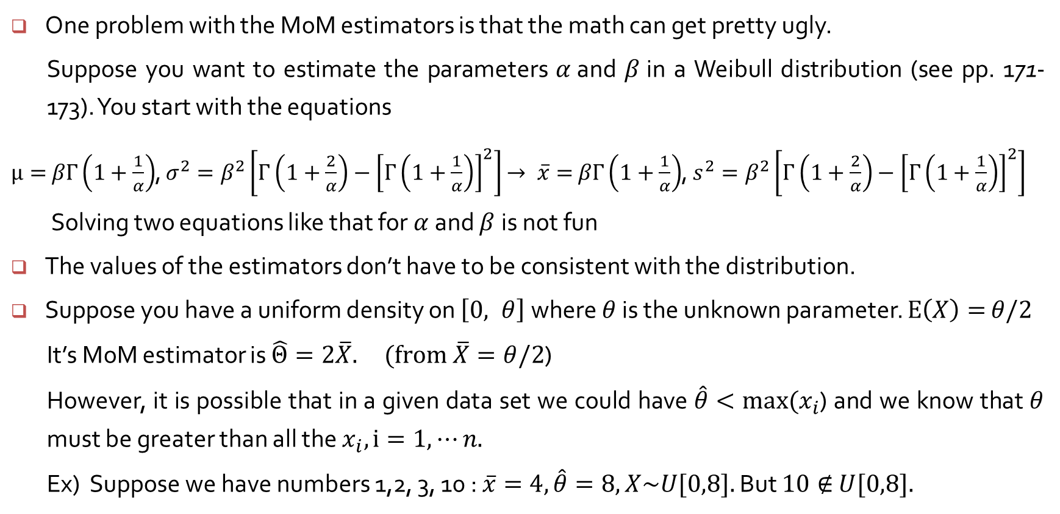
What could be wrong with the MoM estimators?
One problem with the MoM estimators is that the math can get pretty ugly.
Suppose you want to estimate the parameters $α$and $β$in a Weibull distribution (see pp. 171-173). You start with the equations
$μ=$ $βΓ\left(1+\frac{1}{α}\right)$, $σ^{2}=β^{2}\left[Γ\left(1+\frac{2}{α}\right)−{\left[Γ\left(1+\frac{1}{α}\right)\right]}^{2}\right]$ $→ \overline{x}=$ $βΓ\left(1+\frac{1}{α}\right)$, $s^{2}=β^{2}\left[Γ\left(1+\frac{2}{α}\right)−{\left[Γ\left(1+\frac{1}{α}\right)\right]}^{2}\right]$
Solving two equations like that for $α$and $β$is not fun
The values of the estimators don’t have to be consistent with the distribution.
Suppose you have a uniform density on $\left[0, θ\right]$where $θ$ is the unknown parameter. $E\left(X\right)=$ $θ/2$
It’s MoM estimator is $\hat{Θ}=2\overline{X}. (from \overline{X}=θ/2$)
However, it is possible that in a given data set we could have $\hat{θ}<max⁡(x_{i}$) and we know that $θ$ must be greater than all the $x_{i}, i=1, ⋯n.$
Ex) Suppose we have numbers 1,2, 3, 10 : $\overline{x}=4, \hat{θ}=8, X\sim U[0,8].$ But $10∉$ $U[0,8].$

